Slide 1
facial recognition

Slide 2
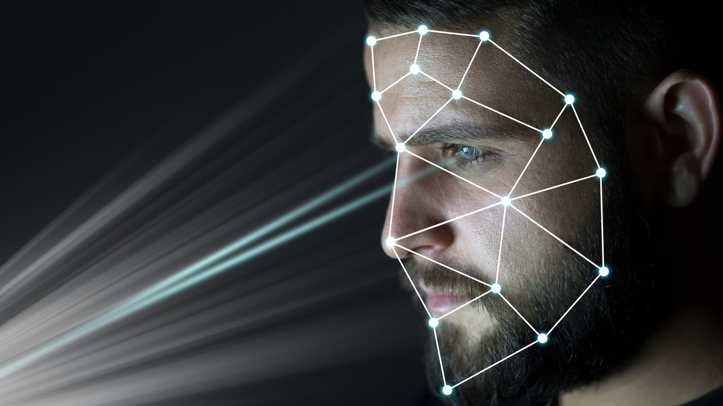
What is facial recognition?
>Facial recognition is a way of identifying or confirming an individual’s identity using their face.
Facial recognition systems can be used to identify people in photos, videos, or in real-time.

Slide 3
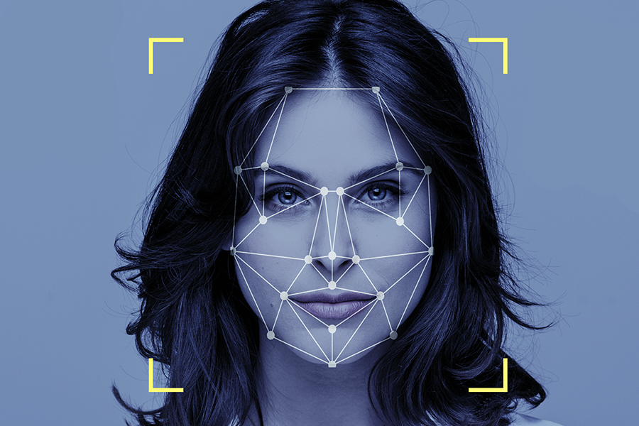
How does facial recognition work?

Slide 4

>Many people are familiar with face recognition technology through the FaceID used to unlock iPhones.
>Typically, facial recognition does not rely on a massive database of photos to determine an individual’s identity.
>it simply identifies and recognizes one person as the sole owner of his device, while limiting access to others.
>Beyond unlocking phones, facial recognition works by matching the faces of people walking past special cameras, to images of people on a watch list.

Slide 5
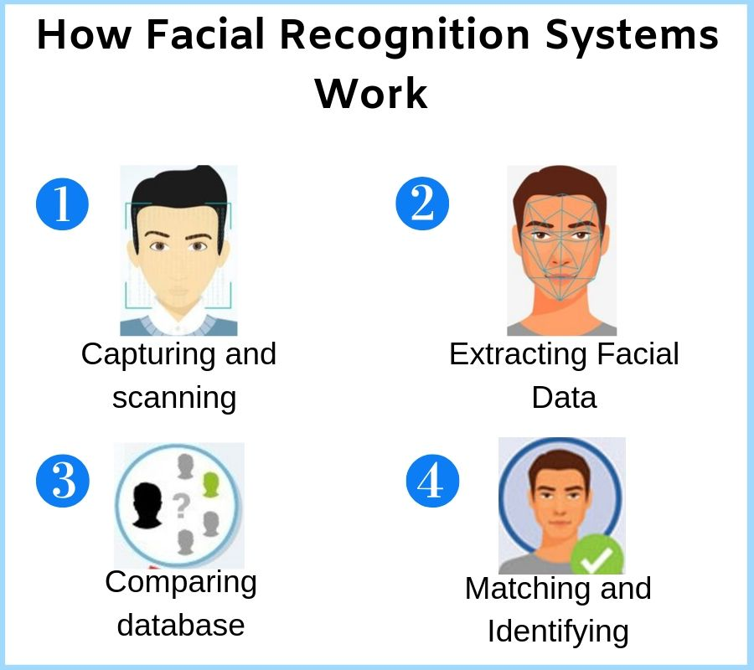
Working

Slide 6
General steps of Facial recognition
-> Step 1: Face detection.
-> Step 2: Face analysis.
-> Step 3: Comparing with database.
-> Step 4: Finding a match.

Slide 7
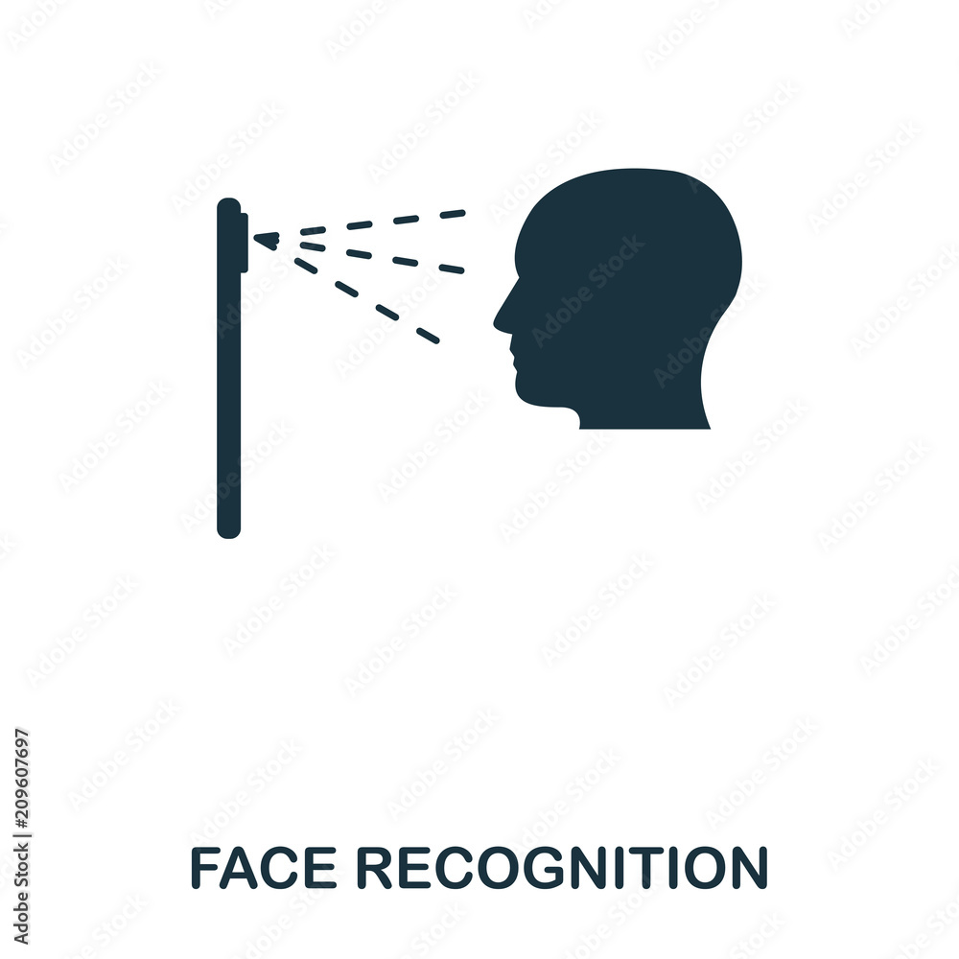
How facial recognition is used
The technology is used for a variety of purposes.
->Unlocking phones. ->Law enforcement ->Airports and border control ->Finding missing persons ->Tracking student or worker/student attendance

Slide 8

Advantages of face recognition
-> Increased security
-> Reduced crime
-> Faster processing
-> Greater convenience
-> Integration with other technologies
Increased security
Reduced crime
Faster processing
Greater convenience
ntegration with other technologies

Slide 9
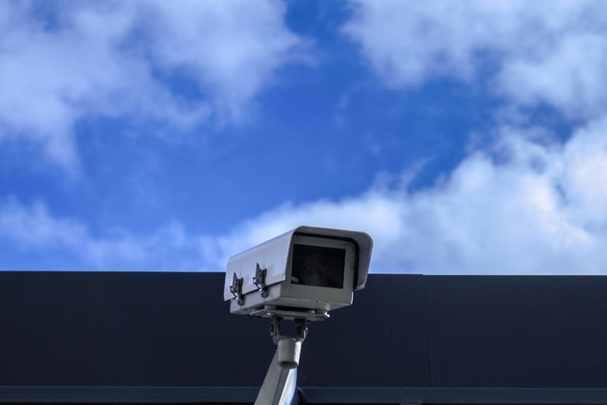
Disadvantages of face recognition
->Scope for error
->Surveillance
->Breach of privacy
->Massive data storage

Slide 10



THE BEST PROGRAMMING LANGUAGES FOR FACE RECOGNITION
=>OpenCV (Open Computer Vision). =>Java.
=>C/C++/C#.
=>Python.

Slide 11


